Slide 1
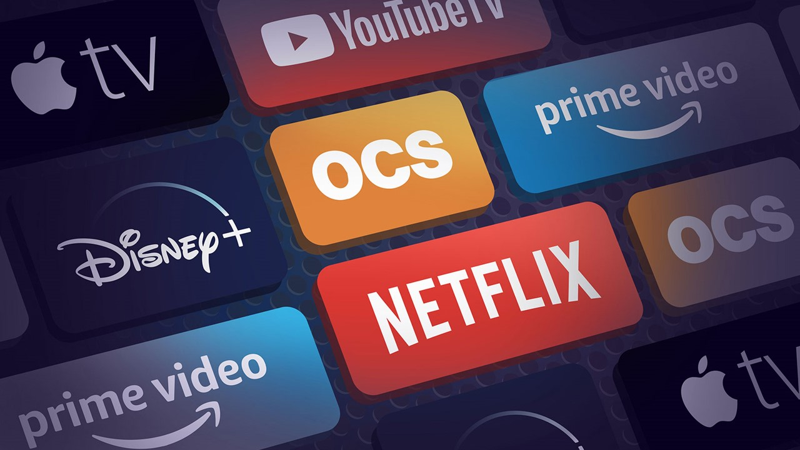
CPDA-Batch 1- Graded Assignment: Streaming Services User Analysis
Snigdha Datta

Slide 2

Table of Contents
Below is the agenda and the points of discussion presented in this report.
01
This section highlights the business model of streaming services companies, their revenue streams, and the relevance of the revenue streams on the overall business objective.
Understanding the Business Model
02
This section provids an overview and key highlights and statistics of the data source, followed by highlighting areas with opportunities.
Understanding the Data
03
This section provides the steps undertaken for cleaning and manipulating the raw data before beginning the analysis.
Data cleaning & manipulation
04
This section provides details of the analyses performed and links to the underlying workbook for the user to navigate through a comprehensive dashboard.
Data Analysis

Slide 3




Understanding the Business Model
Streaming service companies operate under a subscription-based business model, where users pay a recurring fee (monthly or annually) to access a library of digital content, such as movies, TV shows, music, or even games.
AVOD
Core Revenue Streams
Typically, the business model of a streaming services company utilizes a mix of revenue streams. There is SVOD, TVOD, and AVOD.
This dataset pertains to the SVOD i.e. Subscription-based Video on Demand revenue stream and accordingly, the target audience and content strategy are aligned.
Advertising Video on Demand
TVOD
Transactional Video on Demand
SVOD
Subscription-based Video on Demand

Slide 4
Revenue Streams in Light of the Business Objectives
Below is an analysis of how the revenue streams of streaming services companies align with and support their business goals and objectives.
Revenue Streams | Relevance to the Business Objectives
Subscription Fees | Directly supports the goal of profitability by generating recurring income. Subscriptions also incentivize continuous improvement of content quality and user experience to retain customers.
Ad Revenue | Aligns with the goal of reaching a broader audience, including those who prefer free or low-cost options. Additionally, ad revenue helps fund content acquisition and creation, supporting diversity in the library.
Content Licensing & Sales | Generates additional income to fund the production of original content, aligning with the goal of differentiation. Licensing also aids global expansion by making content available on other platforms in untapped markets.
Partnerships & Bundles | Facilitates global expansion and enhances user acquisition by offering value through bundled services. Helps improve accessibility to new audience segments and strengthens the platform's competitive positioning.

Slide 5
Understanding the Data - Overview
Below is an overview of the data and the key highlights to understand the data. The data pertains to user and usage statistics of the streaming services company, and is provided for 3 primary subscription plans having a user base ranging from ages 18 to 55+.
Subscription Plans
Key Statistics
Premium
Most Common Payment Method
15.99
Most Popular Genre
Standard
02
11.99
01
Drama
Debit Card
Basic
7.99
Language Preference
Country with highest no. of users
03
04
The highest user volume is seen in the $7.99 plan, followed by $11.99,
The $15.99 tier, despite lower adoption, contributes significantly to revenue.
Majority of the user base is clustered in the lower and mid-tier plans, showcasing price sensitivity among the user demographic.
Mandarin
USA
Most active Age Group
Preferred Watch Time
05
06
25-34 years
Late Night
Commonly used Device
Highest Loyalty Points
07
08
Desktop
4990, for 330 watch hrs

Slide 6
Understanding the Data – Areas with Opportunity
Below is an overall understanding of the data and the opportunity window for each of the project objective.
1
2
3
Subscription & Revenue trend
Demographic & Behaviour
Engagement & Watch Patterns
Premium-tier ($15.99) contributes significantly to the revenue.
Transitioning mid-tier subscribers ($11.99) to higher tiers with added value content can be explored.
Users aged 18–24 represent a smaller segment, suggesting targeted marketing for this demographic.
Mandarin, Hindi, and French are popular, indicating the need for multilingual content strategies.
Content in niche genres like Sci-Fi or Documentary sees engagement among specific groups.
The dataset includes high watch hours among certain users, showcasing loyalty or binge behavior.
Users with active parental controls hint at family-centric segment.
4
5
Device Usage Insights
Payment Insights
Desktops are the primary access point, followed closely by smartphones.
Least used devices include smart TVs and tablets, suggesting potential for app enhancements on these devices.
Localization in payment preferences could unlock new opportunities in regional markets.
Users with high loyalty points correlate with higher watch hours, indicating successful retention strategies.

Slide 7



Data Cleaning and Manipulation
Below are the steps undertaken for cleaning and manipulating the raw data before beginning the analysis.
Correct Data Types
Handle Outliers
We have ensured that Columns like Monthly_Price, Watch_Hours, and Loyalty_Points are numeric.
Used statistical method like Z-score to identify outliers in column Loyalty_Points.
Standardize Formats
Create Derived/ Helper Columns
We ensured that all the date columns (Join_Date, Last_Login) follow a consistent format i.e. DD-MM-YYYY.
We also rounded columns like Average_Rating_Given to one decimal place for consistency.
We inserted derived columns like No. of days of active subscription & Subscription Plan for the analysis.
Handle Duplicates
Consistency Checks
We checked for duplicate entries in the data. Some names under User_Name were duplicate but since their User_ID was unique, they have been retained as unique entries for the analysis.
We verified logical relationships btween the data. E.g. we verified if No. of Days of Active Subscription is consistent with Join_Date and Last_Login, and highlighted the inconsistent cells in red. These however have been retained in the analysis since a user can login before opting for the subscription plan..

Slide 8
Data Analysis – Subscription & Revenue
Below are the detailed analyses of the project objectives, as performed in the CPDA Graded Assignment workbook, and the output thereby.
Objective 1:
Monthly revenue based on different subscription plans
Distribution of users across different price tiers
1
2
3
4
D
5
Extra
Output 1:
This highlights monthly revenue for different subscription plan and also the user distribution across these plans (price points).
The Average Revenue Per User (ARPU) comes to ~$12 with highest revenue coming from the Premium category.

Slide 9
Data Analysis – User Engagement Metrics
Objective 2:
Average watch hours per user
Total movies vs. series watched per user
Impact of recommended content on engagement
1
2
3
4
D
Output 2.1:
This graph highlights the average watch hours per user.
Note: Currently, the data is being represented for a sample no. of users for better representation. Additional users can be added, as required.
Objective 2.2:
This graph highlights the Total Movies vs. Series watched by the users. This data is grouped per the Age groups of the users to make it visually more impactful.
Objective 2.3:
The below table highlights the Impact of recommended content on user engagement. Avg of recommended content is taken across various age-groups of the users.
5
Extra

Slide 10
Data Analysis – Demographic & Behavioural Insights
Objective 3:
Preferred genres by age group
Device usage trends
Peak watch time trends (Morning, Evening, Late Night)
Output 3.1:
This graph highlights the preferred Genre per Age Group.
The most popular within a particular age group is highlighted in the pivot table within the workbook.
1
2
3
4
D
5
Output 3.2:
This graph highlights the device usage trend wherein the first device used by the user and the number of currently active devices are indicated.
Extra

Slide 11
Data Analysis – Demographic & Behavioural Insights
Objective 3:
Preferred genres by age group
Device usage trends
Peak watch time trends (Morning, Evening, Late Night)
Output 3.3:
This graph highlights the peak watch time by the users.
It is categorized by the Most Viewing time and the Age Group of the users.
1
2
3
4
D
Additional Output 3.4:
This is an additional graph highlighting the Subscription plans opted by different age group.
This helps identify which plan can be pitched to which age group.
5
Extra

Slide 12
Data Analysis – Retention & Loyalty
Objective 4:
Membership status (Active vs. Inactive)
Loyalty points distribution
Frequency of logins and content downloads
Output 4.2:
This graph highlights the loyalty points grouped by the users' age. Separately, we have also calculated the High and Low engagement users by using the "Quartile" function.
1
2
3
4
D
Additional Output 4.2:
This graph shows the distribution of loyalty points across users using regression analysis to predict the loyalty points earned, given the watch hours, and thereby arrive at the line of best fit (predicted Y).
Output 4.1:
This graph highlights the active subscribers and currently all the users are active.
5
Extra

Slide 13
Data Analysis – Retention & Loyalty
Objective 4:
Membership status (Active vs. Inactive)
Loyalty points distribution
Frequency of logins and content downloads
Output 4.3:
This graph highlights the login trend based on the subscription plan opted by the users.
1
2
3
4
D
5
Output 4.3:
This graph highlights whether the user has downloaded content or not.
Extra

Slide 14
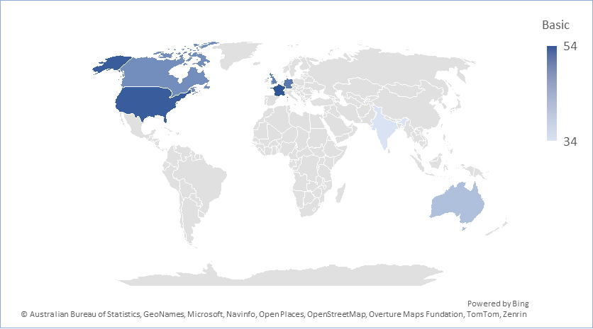
Data Analysis – Payment & Regional Trends
Objective 5:
Preferred payment methods by region
Subscription trends by country
Language preferences and their correlation with engagement
1
2
Output 5.2:
These two graphs highlight the subscription trend i.e. the popular subscription plan in a particular country.
3
4
D
5
`
Extra
Output 5.1:
This graph highlights the preferred payment method by country/ region.

Slide 15
Data Analysis – Payment & Regional Trends
Objective 5:
Preferred payment methods by region
Subscription trends by country
Language preferences and their correlation with engagement
1
2
3
4
D
`
5
Output 5.3:
This graph highlights the engagement level of the users based on the preferred language.
The engagement level can be observed from the average watch hours.
Additional Output 5.4:
This is an additional graph highlighting the language preference by the users across different countries.
Extra

Slide 16
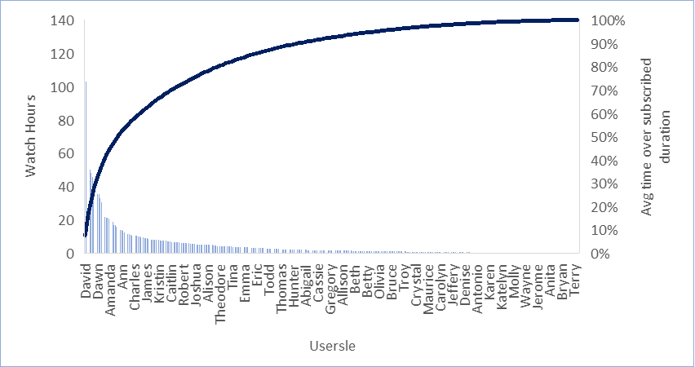
Data Analysis – Additional Parameters
Below are analyses performed on additional parameters with the given data.
1
2
3
4
`
D
Additional Output:
This additional graph highlights the preferred genre watched by the users at the peak watch time.
Additional Output:
This is an additional graph highlighting the average watch time of a user over their subscribed duration. The pareto graph indicates the watch hours of the users in descending order and the cumulative of watch time over the subscribed duration.
5
Extra

Slide 17
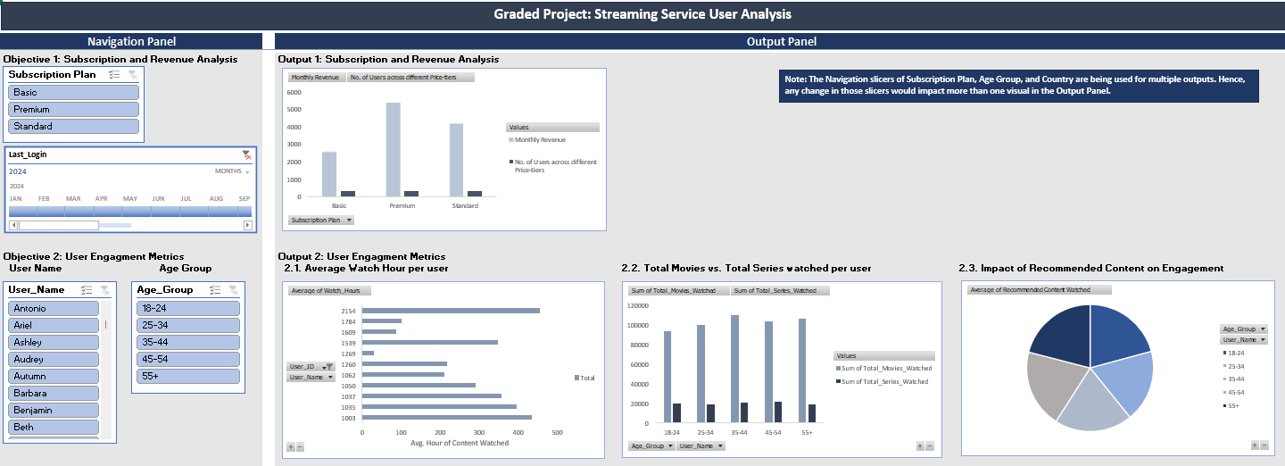
Data Analysis – Comprehensive Dashboard
Below is the comprehensive dashboard created after analyzing each of the project objectives and additional parameters. This report has been generated from the data analysis performed in the CPDA Graded Assignment workbook.
Output Panel: The result of the user interactions, through the navigation panel, is displayed here. The outputs are arranged chronologically; additionally, each of the Pivot Table is linked to the respective chart/ graph, for ease of navigation from the tables to the Dashboard.
Navigation Panel: Users can interact with the dashboard using the slicers within the Navigation Panel.
Note: A few of the slicers help toggle multiple outputs, which are highlighted in the CPDA Graded Assignment workbook.

Slide 18
Thank You!
Please feel free to reach out in case of any queries or feedback.

